Slide 1
Computational Physics (Lecture 3)
PHY4061

Slide 2
PRNG
pseudo-random number generators (PRNG)
perhaps seeding (or initializing) them with the clock.
A perfect pseudo-random number generator appears to be perfectly random,
unless you happen to know both the algorithm and its internal state.
Only discuss pseudo-random numbers.
Let s be the internal state of the PRNG. Then a PRNG is a mapping from one state to another: s_{n+1} = f(s_{n}). The n^{th} random number is then some mapping of the internal state onto the integers or reals.

Slide 3
Desired properties of random numbers
Cycle length.
Any PRNG eventually has to repeat or cycle
since there are a finite number of internal states.
One would like the cycle length to be longer than a typical run.
Consider the worst-case scenario, where all a code is doing is generating PRNs. Suppose a computer now can generate 10⁹ operations/second. If we run it for 1 week we can generate 10¹⁵ = 2⁴⁹ PRNs.
Hence if the PRNG has the maximal cycle length we should have at least 49 bits in the internal state. The continuing increase in computer performance means that methods that worked in the past, may fail with tomorrow's computers.
Luckily, it is easy to make very long cycle lengths.

Slide 4
Desired properties of random numbers
Uniformity.
if we go through a complete cycle, all the integers occur once.
Usually uniformity is easy to guarantee if you go over an entire cycle.
Correlation
completely uncorrelated with each other.
any average such as:
< f₁(x_{i+1}) f₂(x_{i+2}) . . . f_{k}(x_{i+k}) > = < f₁(x_{i+1}) > < f₂(x_{i+2}) > . . . < f_{k}(x_{i+k}) >
for any set of functions f. The average is over all internal states of the random number generator.
Monte Carlo simulations of statistical mechanics
sensitive to very long-range correlations.
Which particular correlations they are sensitive to is not very obvious, so often the only real test to run the code for a case where the exact answer is known or alternatively to try several different PRNGs.

Slide 5
Common types of PRNG
Linear congruential generator:
x_{i+1} = (ax_{i} + b) mod c,
where a, b, and c are magic numbers: their values determine the quality of the generator.
One common choice, a = 7⁵ = 16 807, b = 0, and c = 2³¹ − 1 =2 147 483 647,
excellent for generating unsigned 32-bit random integers.
It has the full period of 2³¹ − 1 and is very fast.

Slide 6
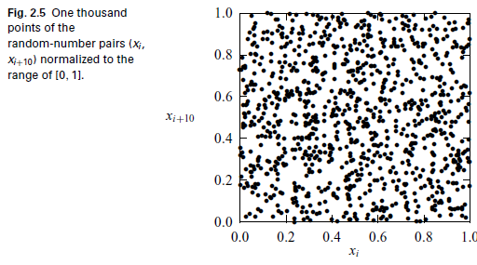
Very homogeneous and
random. There are no stripes, lattice structures, or any other visible patterns in
the plot.

Slide 7
// Method to generate a uniform random number in [0,1]
// following x(i+1)=a*x(i) mod c with a=pow(7,5) and
// c=pow(2,31)-1. Here the seed is a global variable.
public static double ranf() {
final int a = 16807, c = 2147483647, q = 127773,
r = 2836;
final double cd = c;
int h = seed/q;
int l = seed%q;
int t = a*l-r*h;
if (t > 0) seed = t;
else seed = c+t;
return seed/cd;
}

Slide 8
Seed from system time
In order to start the random-number generator differently every time,
we need to have a systematic way of obtaining a different initial seed.
Almost every computer language has intrinsic routines to report the current time in an integer form, and we can use this integer
to construct an initial seed

Slide 9
GregorianCalendar t = new GregorianCalendar();
int t1 = t.get(Calendar.SECOND);
int t2 = t.get(Calendar.MINUTE);
int t3 = t.get(Calendar.HOUR_OF_DAY);
int t4 = t.get(Calendar.DAY_OF_MONTH);
int t5 = t.get(Calendar.MONTH)+1;
int t6 = t.get(Calendar.YEAR);
seed = t6+70*(t5+12*(t4+31*(t3+23*(t2+59*t1))));
if ((seed%2) == 0) seed = seed-1;
To initiate the 64-bit generator, we can use the method getTime() from the Date
class in Java, which returns the current time in milliseconds in a 64-bit (long)
integer, measured from the beginning of January 1, 1970.

Slide 10
Other PRNG
Tausworth Generator.
I_{i} = I_{i - 250}XORI_{i-147,}
where XOR indicates a bitwise exclusive-or operation. This is very fast on the computer. It also has a very long internal state (the last 250 integers). Hence the cycle length is very long. It must be seeded correctly otherwise it can get stuck.
Lagged Fibbonacci generator.
I_{i} = ( I_{i - 250} + I_{i-147} ) mod 2^{M}
This differs from the Tausworth generator because it is regular addition (modulo 2^{M}).
INPUT A B |  | OUTPUT A XOR B
0 | 0 | 0
0 | 1 | 1
1 | 0 | 1
1 | 1 | 0

Slide 11
How to generate random numbers following a certain distribution?
Inverse transform sampling method.
Acceptance and rejection method.
Sample a point (an x-position) from the proposal distribution.
Draw a vertical line at this x-position, up to the curve of the proposal distribution.
Sample uniformly along this line (i.e. uniformly from 0 to the value of the proposal distribution (maximum of the probability density function)). If the sampled value is greater than the value of the desired distribution at this vertical line, return to step 1.

Slide 12
Interpolation
Computer is a system with finite number of discrete states.
In numerical analysis, the results obtained from computations are always approximations of the desired quantities and in most cases are within some uncertainties.
Interpolation is needed
When we need to infer some information from discrete data.

Slide 13
The simplest way to obtain the approximation of f (x) for x ∈ [x_{i} , x_{i+1}] is to construct a straight line between x_{i} and x_{i+1}.
Lagrange interpolation and Aitken method.
How to obtain the generalized interpolation formula passing through n data points?

Slide 14
Least-square approximation
The global behavior of a set of data in order to understand the trend.
The most common approximation: based on the least squares of the differences between the approximation pm(x) and the data f (x).
What’s the proper way to handle data with highly oscillated nature?

Slide 15
Spline approximation
A set of data that varies rapidly over the range of interest
A typical spectral measurement that contains many peaks and dips.
fit the function locally and to connect each piece of the function smoothly.
A spline
interpolates the data locally through a polynomial
fits the data overall by connecting each segment of the interpolation polynomial by matching the function and its derivatives at the data points.

Slide 16
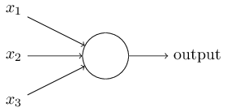
Artificial neural network
Inspired by the biological neural networks
Can be regarded as a special kind of interpolation.
Perceptron
weights, w1,w2,…, real numbers expressing the importance of the respective inputs to the output.
The neuron's output, 0 or 1,
determined by whether the weighted sum ∑w_{j}x_{j} is less than or greater than some threshold value.

Slide 17
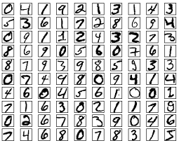
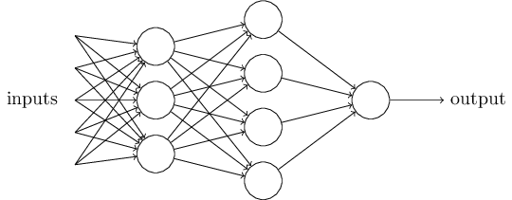
Training data
Public layer and hidden layers
a layer in between input layers and output layers
machine learning models focus on the construction of hidden layers

Slide 18
Numerical Calculus
the heart of describing physical phenomena.
The velocity and the acceleration of a particle are the first-order and second-order time derivatives of the corresponding position vector…

Slide 19
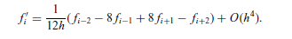
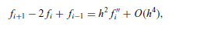
Numerical differentiation
Taylor exapnsion:
f (x) = f (x0) + (x − x0) f ‘(x0) + (x − x0)²/2! f’’ (x0)+ · ·
The first-order derivative of a single-variable function f (x) around a point x_{i} is defined from the limit
f ‘(x_{i} ) = lim (Δ x→0) [f (x_{i} + Δx) − f (x_{i} )] / Δ x
divide the space into discrete points xi with evenly spaced intervals, h.
f _{i}’= (f_{i+1} − f_{i})/h + O(h).
Can be improved if we expand around i+1 and i-1:
f _{i}’= (f_{i+1} − f_{i-1})/2h+ O(h).
A five point formula:
For a second-order derivative. A three point formula is given by the combination:

Slide 20
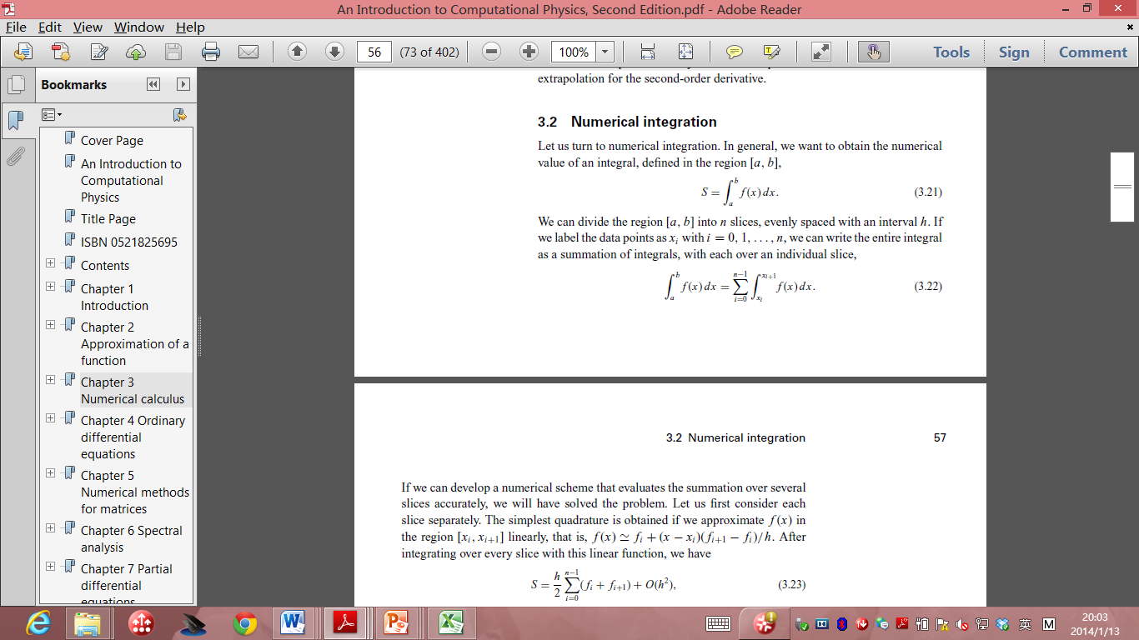
Numerical Integrations
For a integral:
We just divide the region [a,b] into n slices with an interval of h.

Slide 21
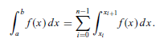
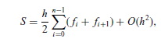
Trapezoid rule
In the standard integration method
To evaluate the integration of each slice, we can approximate the f(x) in the region linearly.
F(x) = fi+(x-x_{i})(f_{i+1}-f_{i})/h
Integrating each slice, we have

Slide 22
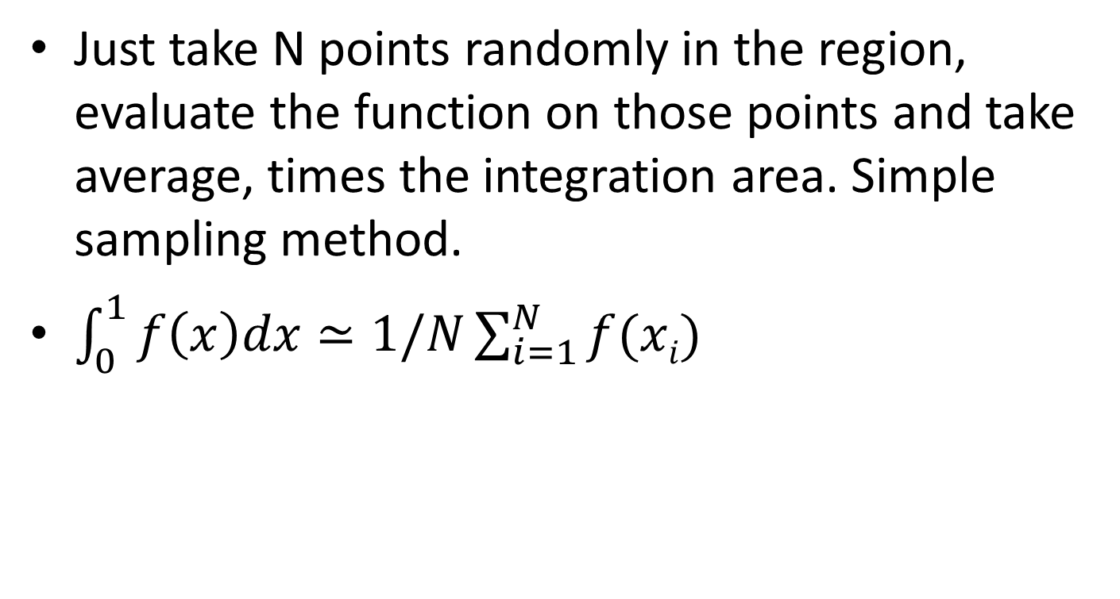
Random method
Just take N points randomly in the region, evaluate the function on those points and take average, times the integration area. Simple sampling method.
$\int_{0}^{1}{f\left(x\right)dx}≃1/N\sum_{i=1}^{N}{f(xi)}$

Slide 23
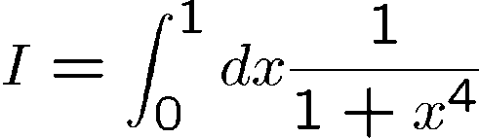







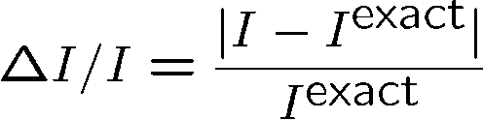
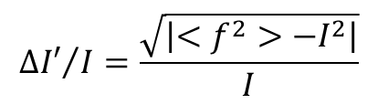
Two Problems:
Calculate: accurate value:
10² | 0.879679 | 1.47x 10⁻² | 1.69 x 10⁻² | 0.1 | 1.69 x 10⁻¹
10³ | 0.871238 | 4.92x 10⁻³ | 5.45 x 10⁻³ | 3.16x 10⁻² | 1.72x 10⁻¹
10⁴ | 0.869603 | 3.03 x 10⁻³ | 1.74 x 10⁻³ | 10⁻² | 1.74 x 10⁻¹
10⁵ | 0.866777 | 2.26 x 10⁻⁴ | 5.61x 10⁻⁴ | 3.16x 10⁻³ | 1.77 x 10⁻¹
10⁶ | 0.866876 | 1.11x 10⁻⁴ | 1.77x 10⁻⁴ | 0.001 | 1.77 x 10⁻¹
10⁷ | 0.867004 | 3.63x 10⁻⁵ | 5.60x 10⁻⁵ | 3.16x 10⁻⁴ | 1.77x10⁻¹
10⁸ | 0.866947 | 2.97x 10⁻⁵ | 1.77x 10⁻⁵ | 10⁻⁴ | 1.77x10⁻¹
10⁹ | 0.866956 | 1.89x 10⁻⁵ | 5.60x 10⁻⁶ | 3.16x 10⁻⁵ | 1.77 x 10⁻¹
$${∆I′}/I=\frac{\sqrt{\left|<f^{2}>−I^{2}\right|}}{I}$$

Slide 24
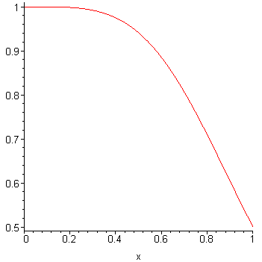
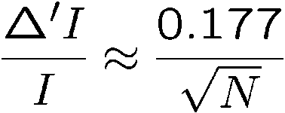
F(x)
Relative error as a function of N

Slide 25
Sample code to illustrate the simple sampling method
// An example of integration with direct Monte Carlo
// scheme with integrand f(x) = x*x.
import java.lang.*;
import java.util.Random;
public class Monte {
public static void main(String argv[]) {
Random r = new Random();
int n = 1000000;
double s0 = 0;
double ds = 0;
for (int i=0; i<n; ++i) {
double x = r.nextDouble();
double f = x*x;
s0 += f;
ds += f*f;
}
s0 /= n;
ds /= n;
ds = Math.sqrt(Math.abs(ds-s0*s0)/n);
System.out.println("S = " + s0 + " +- " + ds);
}
}

Slide 26
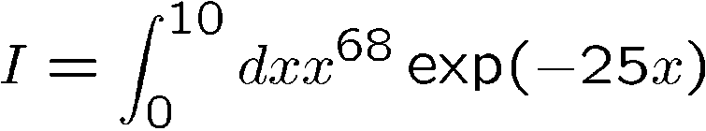
Example 2:
Calculate:
Accurate result:
Using the above method:
10² | 0.52577 | 0.392 | 0.287 | 0.100 | 2.87
10³ | 0.79895 | 0.755x 10⁻¹ | 0.900x 10⁻¹ | 0.316x10⁻¹ | 2.85
10⁴ | 0.88543 | 0.246 x 10⁻¹ | 0.269 x 10⁻¹ | 0.100 x 10⁻¹ | 2.69
10⁵ | 0.87210 | 0.919 x 10⁻² | 0.864x 10⁻² | 0.316x 10⁻² | 2.73
10⁶ | 0.86581 | 0.190x 10⁻² | 0.274x 10⁻² | 0.100x 10⁻² | 2.74
10⁷ | 0.86485 | 0.798x 10⁻³ | 0.868 x 10⁻³ | 0.316 x 10⁻³ | 2.74
10⁸ | 0.86377 | 0.456 x 10⁻³ | 0.275 x 10⁻³ | 0.100 x 10⁻³ | 2.75
10⁹ | 0.86418 | 0.218 x 10⁻⁴ | 0.868 x 10⁻⁴ | 0.316x10⁻⁴ | 2.75

Slide 27
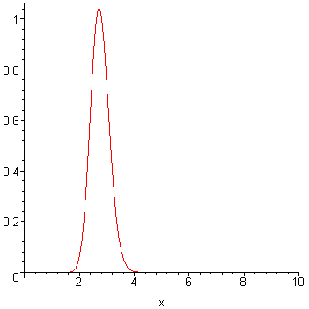
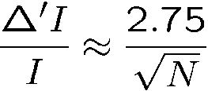
In this example
The function is significant in the range of [2,4]
So it’s no good to eventually divide [0,10]

Slide 28
Introduction to Crystal structure -continued

Slide 29
reciprocal lattice
Important to study reciprocal lattice
Primitive translation vectors t1, t2 and t3
In the reciprocal space, we have g1, g2 and g3
t_{i}∙g_{j} =2 πδ_{ij}
2 π factor is to simplify some expressions.
If a crystal rotation of t1, t2, t3 is performed in the direct space,
the same rotation of g1, g2, g3 occurs in the reciprocal space.
The propagation of wavevector k of a general plane wave exp(ik∙r) has the reciprocal length dimension!

Slide 30
reciprocal space
All the points defined by the vectors of the type:
g_{m} = m₁ g₁ + m₂ g₂ + m₃ g₃
Reciprocal lattice
Note: Only related to the translation properties of the crystal and not to the basis.
Solve that general equation, we have:
g₁=2π (t₂ x t₃) / Ω Ω = t_{1 ·}(t₂ х t₃) volume of the primitive cell
g₂=2π (t₃ x t₁) / Ω
g₃=2π (t₁ x t₂) / Ω
Examples：sc <==> sc fcc <==> bcc bcc <==> fcc

Slide 31
Useful Properties
The direct and reciprocal lattices obey some simple useful properties
1， the volume Ω_{k} of the unit cell in the reciprocal space is (2π)³ times the reciprocal of the volume of the unit cell in the direct lattice.
Will be assigned as a homework to prove this
2, g _{m}∙t _{n} =integer∙2π
3, If a vector q satisfies the relation , q∙t _{n} =integer∙2π for any t _{n} , q has to be a reciprocacl lattice vector.
4, A plane wave exp(ik ∙r) has the lattice periodicity if and only if the wavevector k equals a reciprocal lattice vector.
W(r) = exp(i g _{m} ∙r)

Slide 32
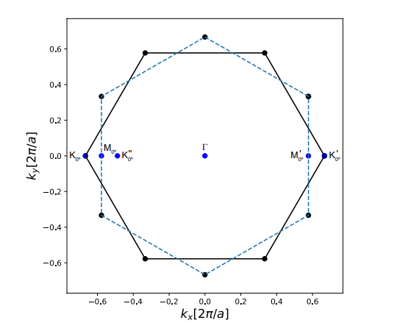

Slide 33
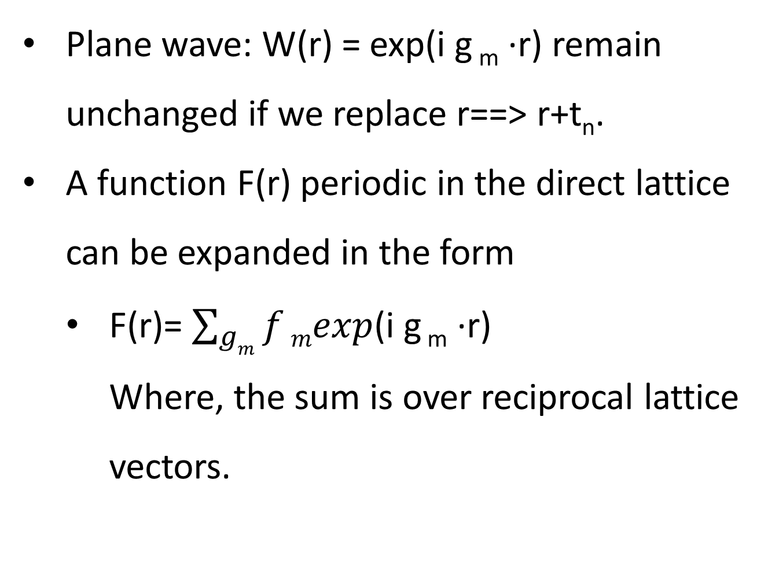
Fourier expansion
Plane wave: W(r) = exp(i g _{m} ∙r) remain unchanged if we replace r==> r+t_{n}.
A function F(r) periodic in the direct lattice can be expanded in the form
F(r)= $\sum_{gm}{f}mexp$(i g _{m} ∙r)
Where, the sum is over reciprocal lattice vectors.

Slide 34
Distance between lattice planes
g _{m}∙t _{n} =integer∙2π
Consider a family of planes in the direct space defined by the equations:
g _{m}∙r =integer∙2π
All translation vectors belong to the family of planes.
The distance between two consecutive planes is d= 2π/ g _{m}
Every reciprocal lattice vector is normal to a family of parallel and equidistant planes containing all the direct lattice points.

Slide 35
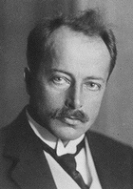
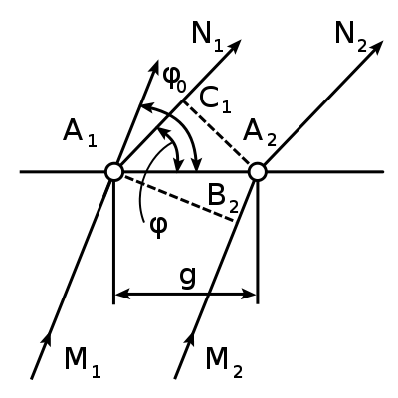
MAX VON LAUE
1914 Nobel Laureate in Physics
for his discovery of the diffraction of X-rays by crystals.

Slide 36
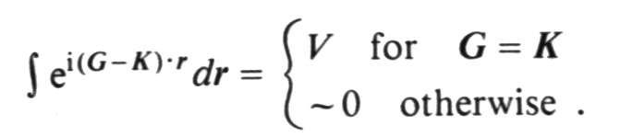
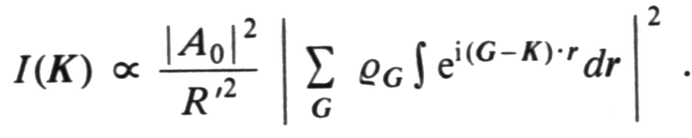
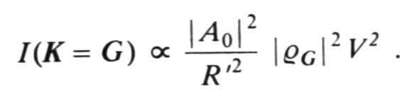
Laue Condition and Bragg rule
Introduce Fourier Components of
Charge density
Suppose G is the reciprocal vector
K is the scattering vector:
difference between the ingoing and outgoing wave vectors.
Laue Condition

Slide 37
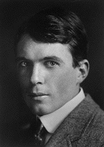
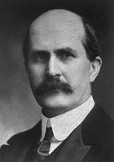
1915 Nobel Laureate in Physics for their services in the analysis of crystal structure by means of X-rays
SIR WILLIAM HENRY BRAGG （1862-1942）
SIR WILLIAM LAWRENCE BRAGG（1890-1971）

Slide 38
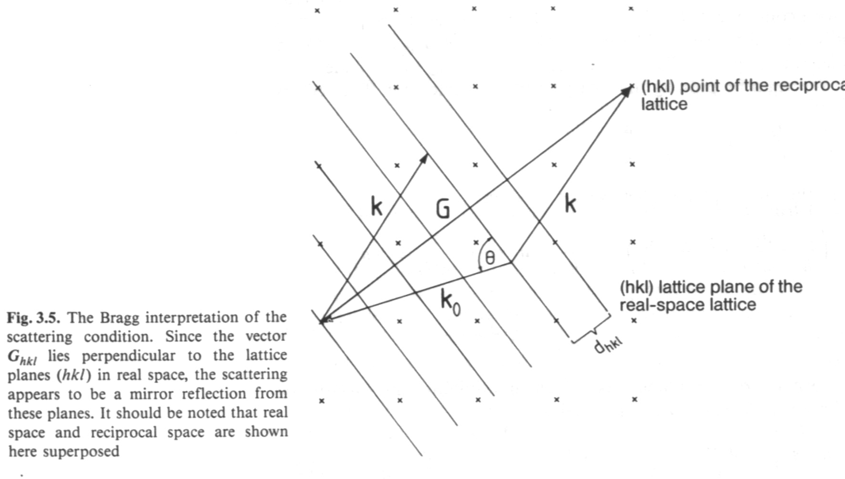
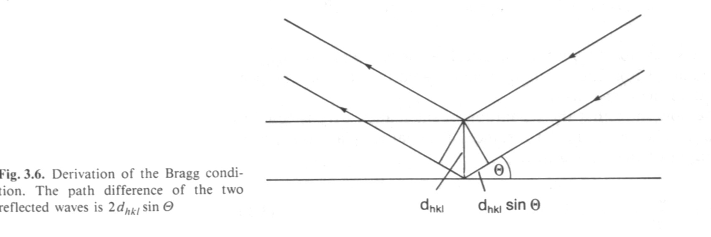
k-k₀=G
elastic diffraction: |k₀|= |k|= |k - G|
Squared 2 k •G = G²
Bragg plane
Laue condition => Bragg law
nλ=2d_{hkl} sin θ

